Slide 1
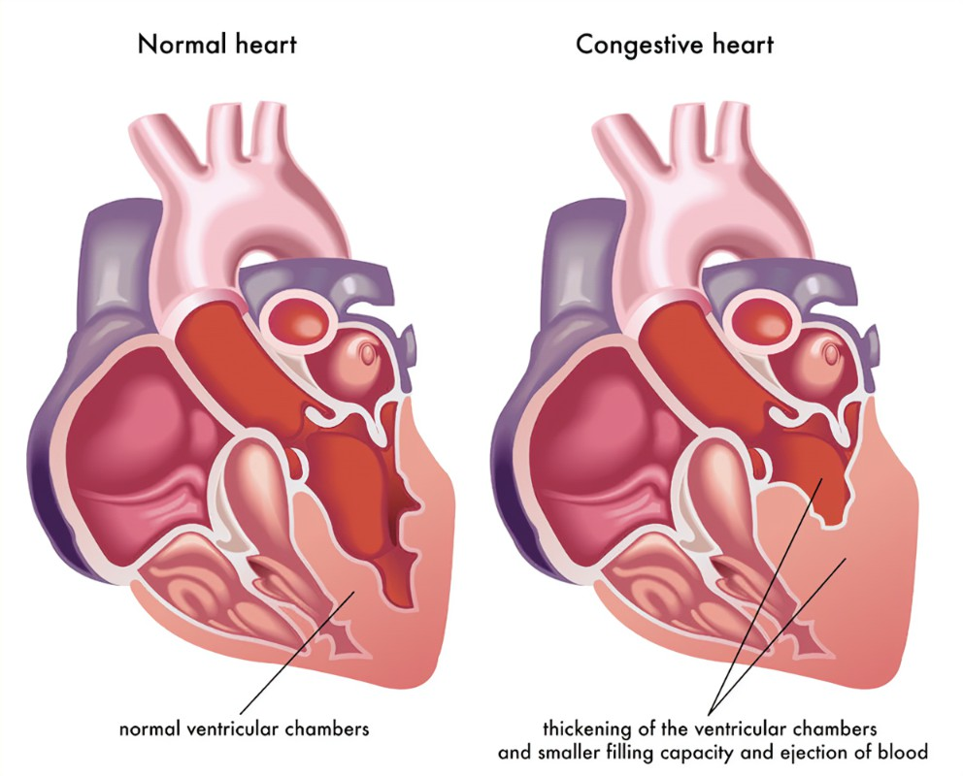
Problem Statement
Congestive heart failure (also called heart failure) is a serious condition in which the heart doesn’t pump blood as efficiently as it should.
Patients have difficulty breathing (orthopnea) while sleeping and need to keep head elevated.
Existing solutions are automatic rising bed or chairs or simply stacking 3-4 pillows, neither of which are portable.
Notes:
Pillavate is a device we developed for patients having congestive heart failure. Congestive Heart Failure, otherwise known as CHF, is a chronic and progressive
condition that affects the patient’s heart muscle pumping powers. It is the fluid buildup around the heart which causes it to pump inefficiently from the weakened heart muscle or muscles,ultimately not being able to provide the correct needs for the body. The symptoms of congestive heart failure include fatigue, chest pain, lack of appetite or nausea, and confusion or impaired thinking. In the case of more severe heart failure, these symptoms can continue even when the person is asleep. I learned about this problem from my sister who is doing her MD and works closely with patients. She told me that the first question a doctor asks the patient having CHF is how many pillows they use to stack while sleeping. Although there are existing solutions for the problem, they are either too large to carry anywhere or have to be manually adjusted throughout the night, affecting the sleep of the person using it. So we decided to look into this problem and make something which can help the patients while being cost-efficient and portable.

Slide 2
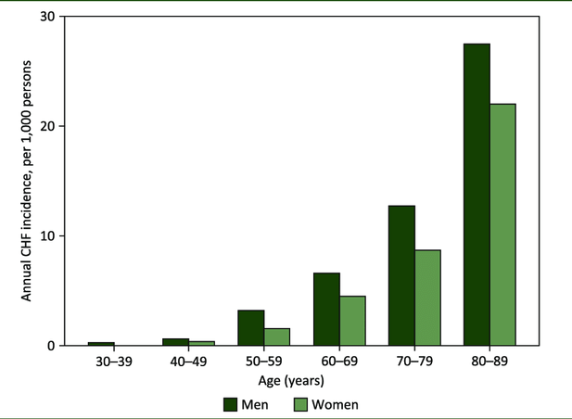
Who does this help?
Current worldwide prevalence of CFH is 65 million cases
Nearly 5 million Americans are currently living with congestive heart failure (CHF).
550,000 new cases are diagnosed in the U.S. each year.
Projected to rise by 46 percent by 2030,
resulting in more than 8 million people with heart failure
Notes:
According to the Global Health Data Exchange registry, the current worldwide prevalence of CHF is 65 million cases. This problem affects people of all ages, from children and young adults to the middle-aged and the elderly. More than 5 million people in the United States have congestive heart failure. It’s the most common diagnosis in hospitalized patients over age 65. One in nine deaths has heart failure as a contributing cause.. As per projections, more than 8 million people could be suffering from congestive heart failure by 2030. Looking at the demographics we can conclude that the project that we are developing could be beneficial to a large group of people in current times and near future.

Slide 3
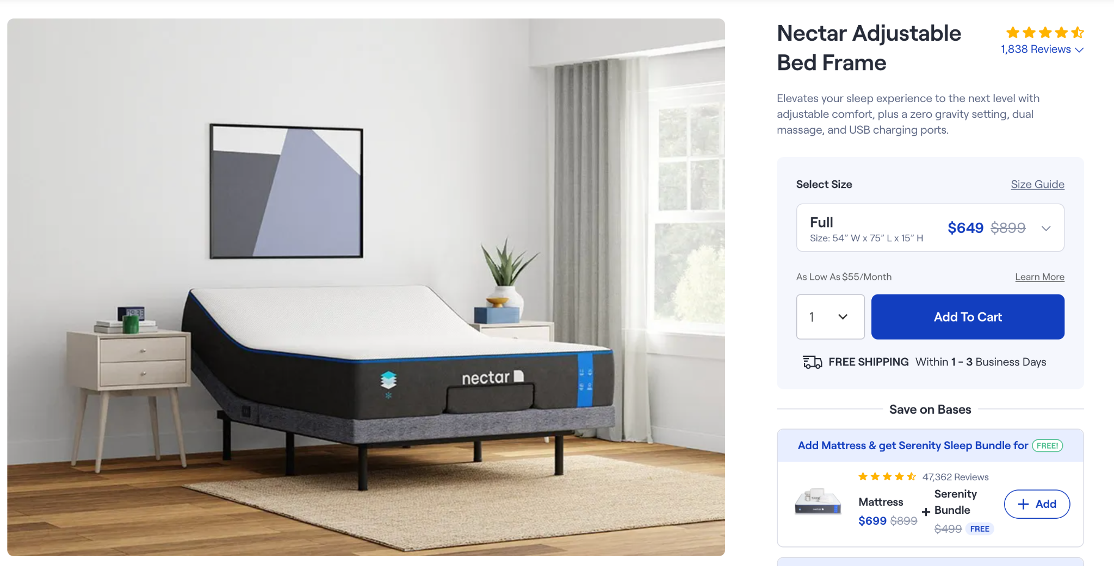
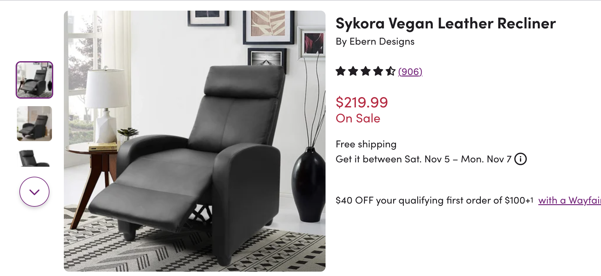
Competitive Landscape
Expensive
Hard to transport
Manually Operated
Notes:
The two main products on the market that can be used to help people with orthopnea consist of adjustable bed frames and adjustable recliners. There are also some invasive products however these typically target with sleep apnea and not those with orthopnea. Both of the physical systems available effectively raise the head, neck, and shoulders of the patients and the patient can adjust the angle of the upper portions as needed to incline themselves. Additionally both systems offer a lot of comfort so patients are still able to fall asleep as they would on a normal bed or chair. However, both options are also very limiting. Adjustable beds and chairs cost hundreds of dollars. Additionally, both choices really anchor the patient to one location as it takes quite a bit of effort to move a heavy bed frame or recliner. Finally both systems rely on manual adjustments meaning the patient has to wake up if they need more of an incline. As a result of the cons many patients opt for stacking pillows which means picking a correct angle becomes a guessing game and patients have to readjust throughout the night. By making the angle a guessing game there are many risks as too low of an angle does not effectively open the patient’s airway, and according to the National Library of medicine too high of an angle can significantly increase the average and peak pressures of the cranial and cervical regions. Additionally pillows can compress or fall over during the night making them ineffective at supporting the head, neck and shoulders of the patient. Our goal is to create a product that patients can transport from one place to another without too much difficulty that is able to adjust in angle based on the patient’s breathing patterns. We have also placed a lot of importance on what angles we use as this is critical in supporting our patients.
https://www.ncbi.nlm.nih.gov/pmc/articles/PMC5012320/

Slide 4

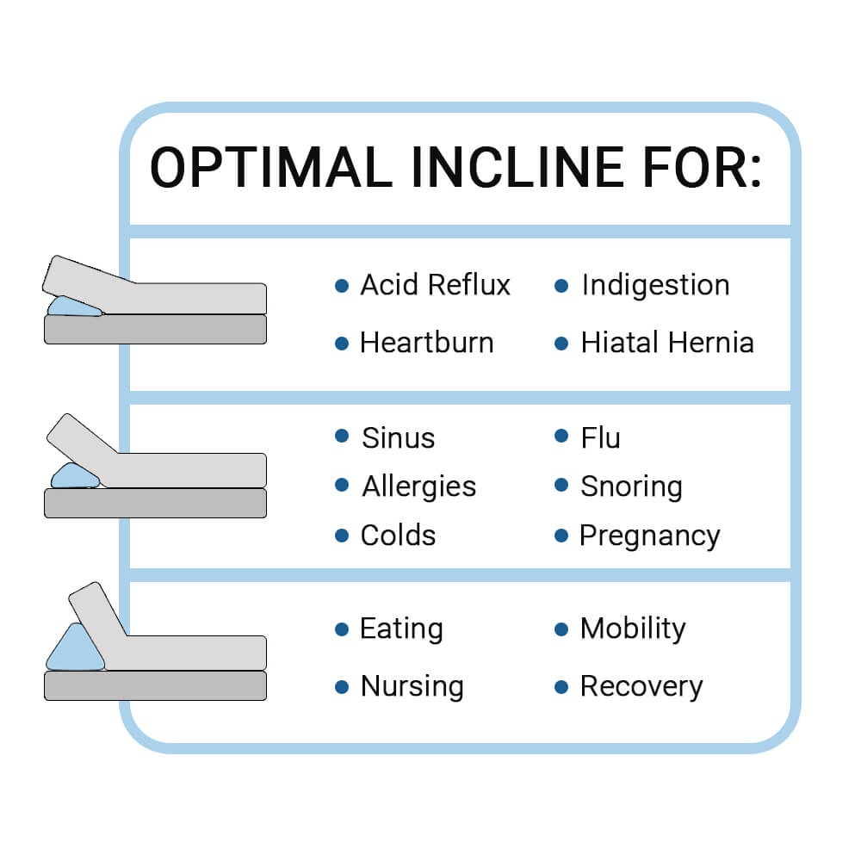


Design Requirements
Meets required elevation angles
Low noise level
Low Cost
Transportable
15-30 degrees
Resting
40-55 degrees
Raised
Notes:
We have narrowed down our design requirements to five critical points that are essential to the functionality of our product. The first is that our product has to meet the angle requirements for the resting and raised head elevations. For patients with orthopnea this differs from someone without their condition as their “resting head elevation” is already slightly raised. Based on our research for the resting state this ranges from 15-30 degrees and for the raised state it is 40-55 degrees. Secondly, it is essential that our product does not make a lot of noise so that it does not disturb a patient in their sleep. Our goal is for the device to make approximately the same amount of noise as a common fan maxing out around 40-70 decibels. In order to be available to all patients our goal is also to keep the cost lower than 200 dollars which is half of any of the products currently available. Finally in order to ensure that our system is transportable, we have set the expectation that any of us should be able to transport and set up our system by ourselves.

Slide 5
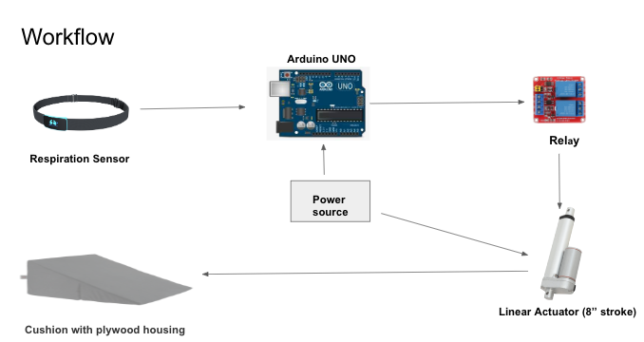
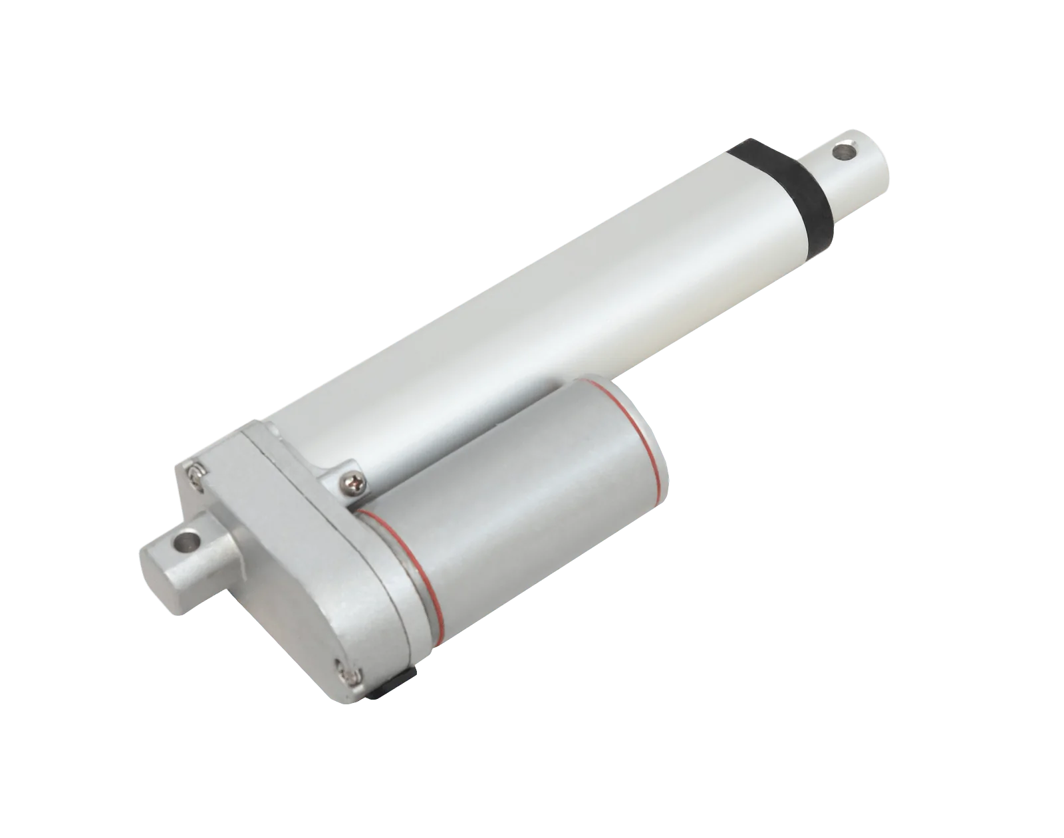
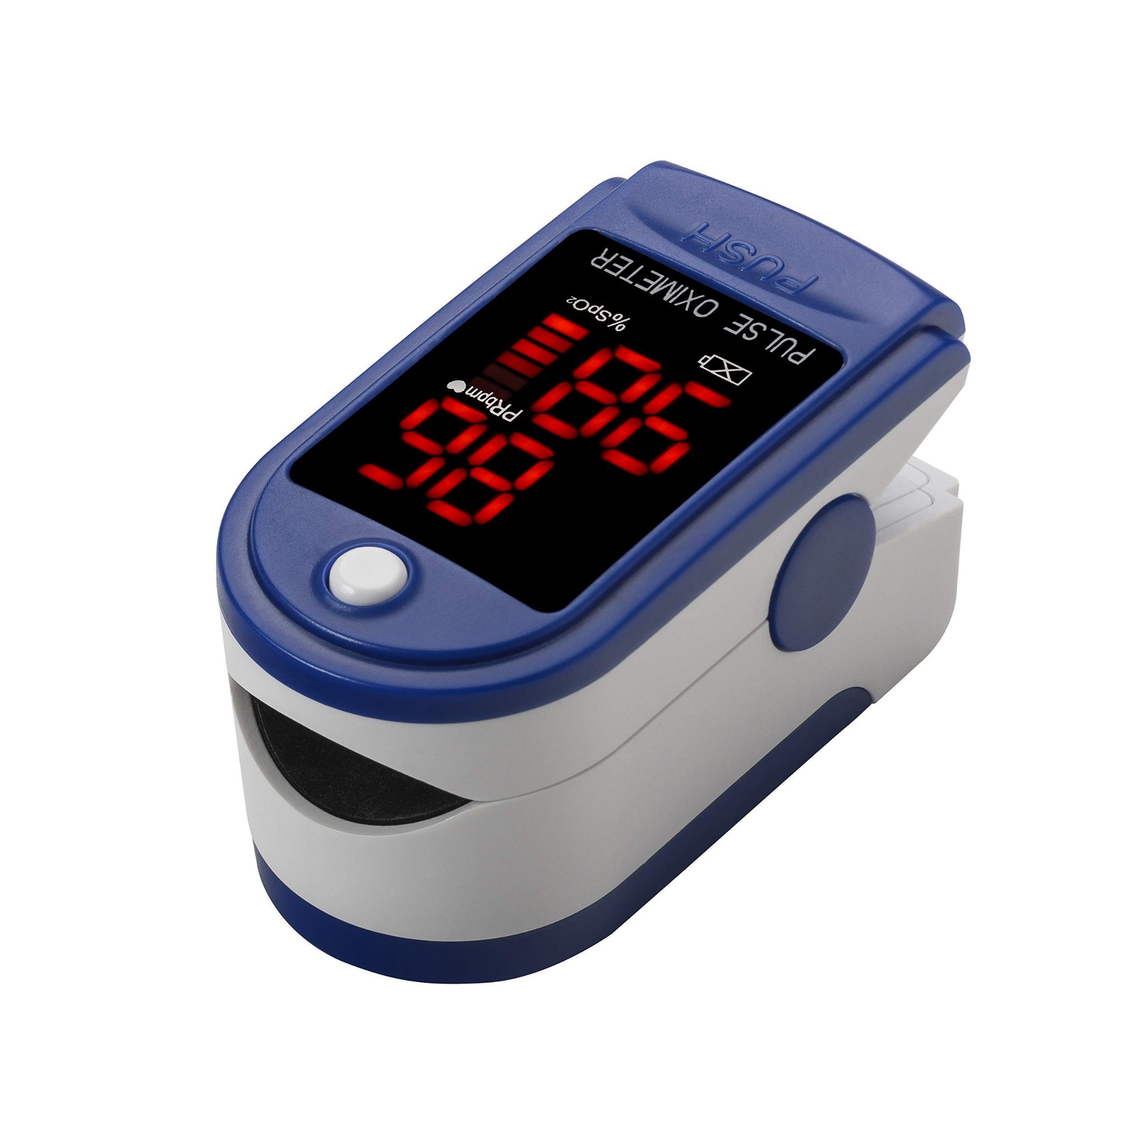
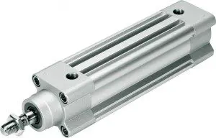
Proposed Solution
Actuation Options
Inflatable
Electrical Linear Actuator
Pneumatic Actuator
Electrical Motor
Sensing Options
Heart rate
Blood Oxygen Saturation
Snoring / Wheezing
Respiratory Sensing Strap
Notes:
So based on our design requirements as well as the solutions that already exist our team developed our proposed design which we presented to you all during our midterm presentation. The most important features within this project for our purposes were the sensing and actuation as our additional hardware could be built around these two critical components. Our proposed solution essentially consisted of a system that can be placed under the patients head and shoulders that goes up and down when signaled by the sensor to do so. For our sensors we considered a couple of different option to detect the breathing patterns and heart rate of the user. We looked into a multitude of heart rate sensors, blood oxygen saturation sensors, a respiratory sensing strap as well as the option of just using a microphone to pick up on sound of snoring or wheezing from the patient. Due to the fact that we wanted to ensure that our system only used data from the user not from the outside environment we decided to use a pulse oximeter which the patient could wear as either a ring or around their wrists similarly to a smart watch. We were able to find data online for the typical trends for patients with congestive heart failure and so choosing this sensor also allowed us to simulate situations in which patients needed additional elevation since none of us have this condition. Now that we had settled on the type of sensor we had to also decide on how we were planning to actuate the pillow. We considered an inflatable pneumatic system as well as an electrical motor. However, we noted the pneumatic system would be too loud to meet our design requirements and for the electrical motor to work for out means we would need a high torque motor or high ratio gear box both of which would increase the complexity, weight, and cost of the system. Therefore, we selected a simple linear actuator since this option would effectively raise and lower the patient’s head. Additionally this option was one of the safest options since the linear actuators that we were looking at use relatively low voltages and speeds and already have a ton of safety features in place. Linear actuators were also perfect in ensuring that the patients head is kept at and raised to the critical angles we identified in our research as we are able to control the heights the actuator moves between.

Slide 6
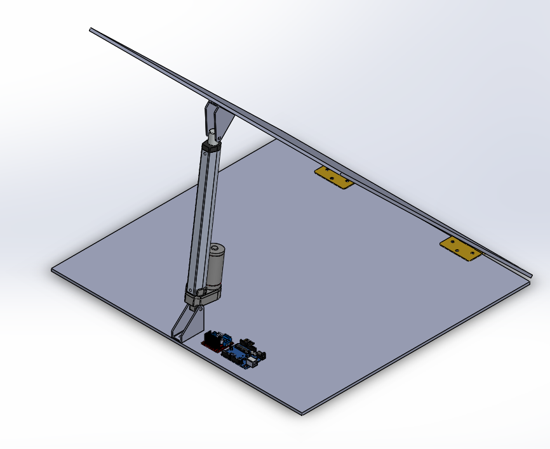

3D model
Notes:
Which brings us to the 3d model of our system which we designed to bring our visions to life. within the video of our cad drawing you can see how our system is able to move the patients head and shoulders up and down. After placing our actuator, we were able to calculate the different heights needed in order to reach the angles specified in our design requirement.

Slide 7
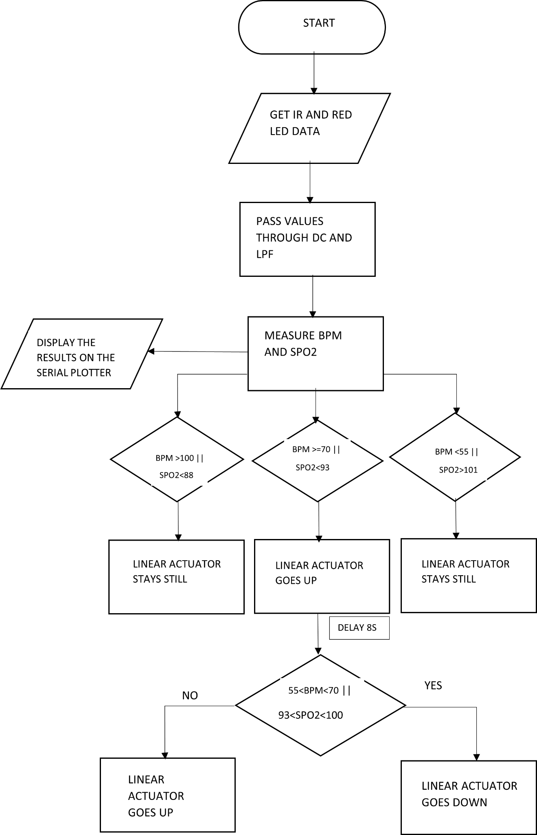
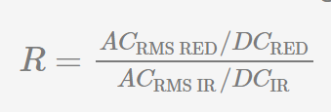
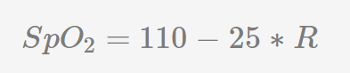

Code flow
Notes:
We begin the code by taking the Infra red and red light values from the sensor and select the required mode
There are 2 modes for this sensor. The first one is IR mode where only IR led is lit up . This mode is sufficient for heart rate
.To measure both heart rate and SpO2 we need both IR and red light data i.e mode 2
Then we take the IR and Red light values from the sensor
After getting the values we found that there is a dc offset of 50000 units.So, we passed this through a DC filter to get only the AC part.
We found higher level harmonies in the IR values after passing through the DC filter so we used a low pass filter to smoothen out the signal.
To measure heart rate we use the IR values and we calculate it taking the difference between the timestamps between the pulses using the formula shown on the screen
To measure the blood oxygen level , we take the ratio of red light data to IR and calculate it based on the formula on the screen
After getting the bpm and spo2 values we check for conditions required for the up and down movement of linear actuator . As the sensor is not accurate when compared to commercially available devices we sometimes get values which are either too high or too low to consider .In those cases we coded our linear actuator to ignore them by making our actuator stay still .The threshold for resting heart rate and blood oxygen level according to a cardiologist is 50-60 bpm and 88-93 SpO2 percent . To make the testing easier we took the threshold values as 55-70 bpm after rounds of asking the participant to hold their breath and release it for testing . As the heart rate increases from 70-100 ,the linear actuator rises continuously for 8 seconds i.e 80mm . After rising ,it checks if the heart rate lowered to optimal level .If yes, the linear actuator goes down and repeats the process again .

Slide 8
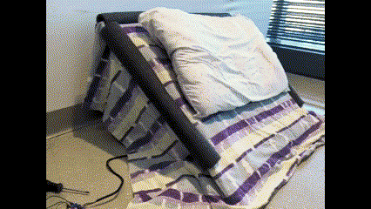
Actual model
Luxury Design
Affordable
Extreme Comfort
Satisfaction Guaranteed
Made in the USA
Highest-Quality Materials
100% Unpaid Student Labor
“It is surprisingly comfortable” -Eva
Notes:
On the right you can see our final prototype design. It is made of the components Eva talked about, with a base of plywood, a linear actuator powered by an external DC power supply, biometric sensors, and some additional aesthetic and comfort features.
We have used the most quality materials to create a luxury design that is both affordable and safe while looking great in any bedroom.
One of our early users was very satisfied with our design, calling it “Surprisingly Comfortable”

Slide 9
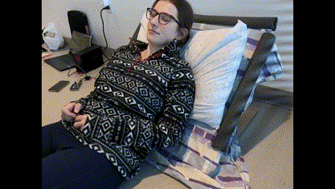
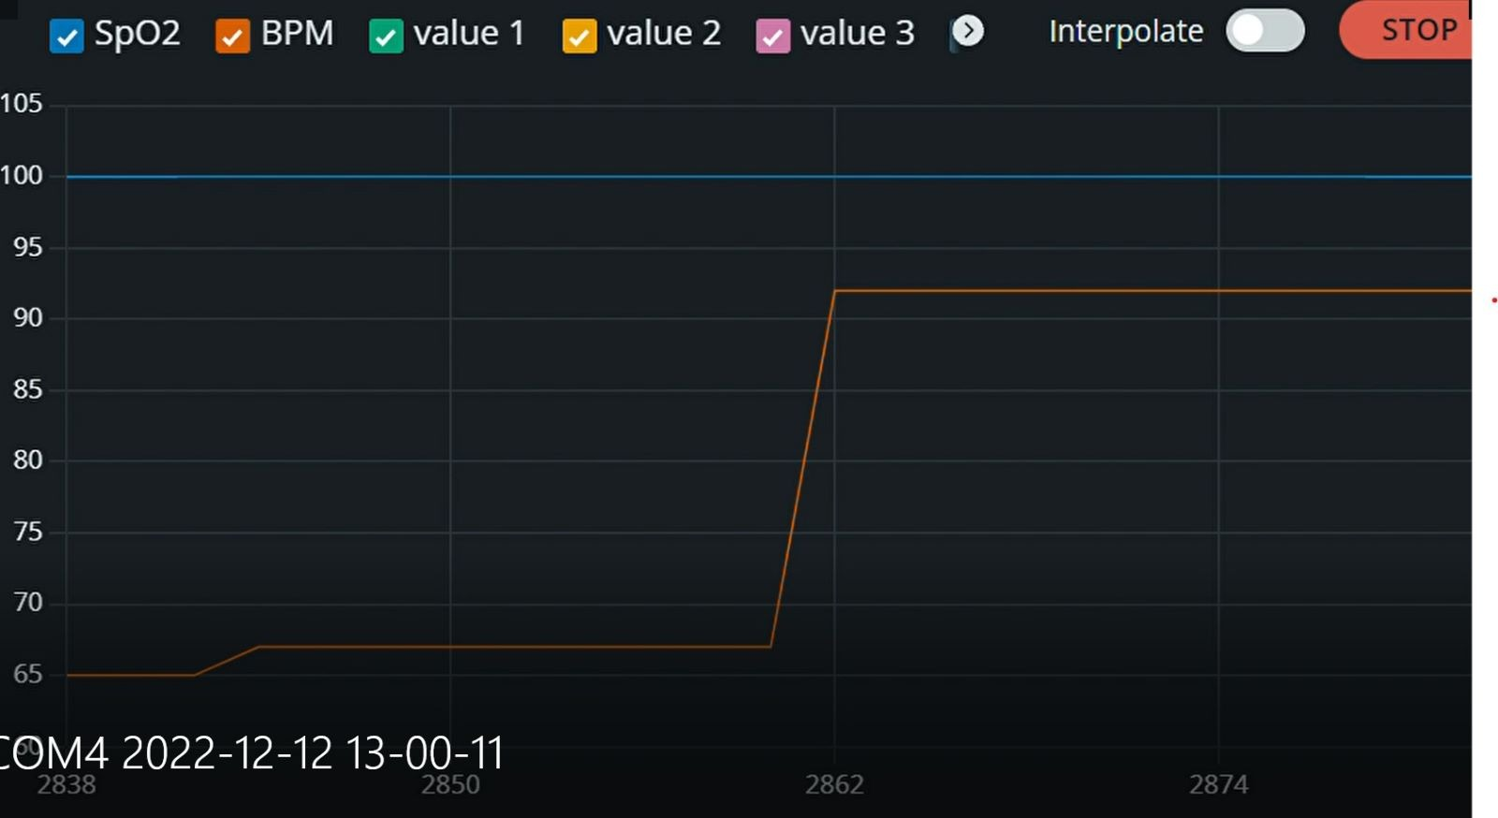
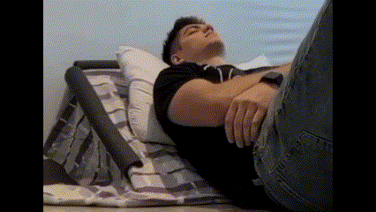
Results
Notes:
Matt
On the left you can see the output from the Arduino Serial Monitor. I highlighted the important part in orange because it was hard to see. This increase in heartrate is beyond the threshold value we defined and results in the actuation of our system.
The video in the top right showcases Eva holding her breath, so as she gasps, her heartrate increases, and the pillow rises. As her heartrate decreases to a normal resting heartrate, the pillow can return her to a normal sleeping angle.
None of us have this condition, but we can feed in an example dataset that would be consistent with samples from patients with congestive heart failure into our system. This is the bottom right video (of me). , so for the video with me in it in the bottom… blah blah
The video with Eva worked by her holding her breath. Blah blah blah.

Slide 10
Bill of Materials
Component | Quantity | Cost
Elegoo Arduino Uno | 1 | 17.99
Motor controller Driver | 1 | 11.49
Linear actuator(12V DC) | 1 | 33.95
Heart rate sensor breakout board | 1 | 6.99
Heart rate sensor module | 2 | 12.99
Hinges | 3 | 6.67
Plywood | 1 | 28.50
Total |  | 118.58
Notes:
We decided to use the ELEGOO UNO R3 BOARD which is a widely used microcontroller. This board uses a 16U2 instead of the ATMega8U2 chip which provides faster transfer rates and more memory that would enable efficient processing. It is also compatible with Arduino IDE and is pre programmed with a bootloader that allows you to upload new code to it without the use of an external hardware programmer.
We also have used a Dual-channel H-bridge motor driver where the working mode provides higher efficiency and low latency.
The Linear actuator that we used has a Stroke length of (8"); Retracted length of (12.8") and an Extended Length of (20.8“). The Travel speed for the stroke length is 0.39 inches/sec which is quite pleasant for the user to use when sleeping as opposed to faster actuation which would startle the user.
It is made of high quality aluminum alloy material, which is sturdy enough to withstand the torso of an individual and a High performance motor with Built-in high quality limit switch. The heart rate sensor can be applied to a wearable device for heart rate and blood oxygen collection, worn on fingers, ear lobes, wrists and other places.
In the end, we were able to stick to the budgetary constraints not compromising the intended vision for the project.

Slide 11
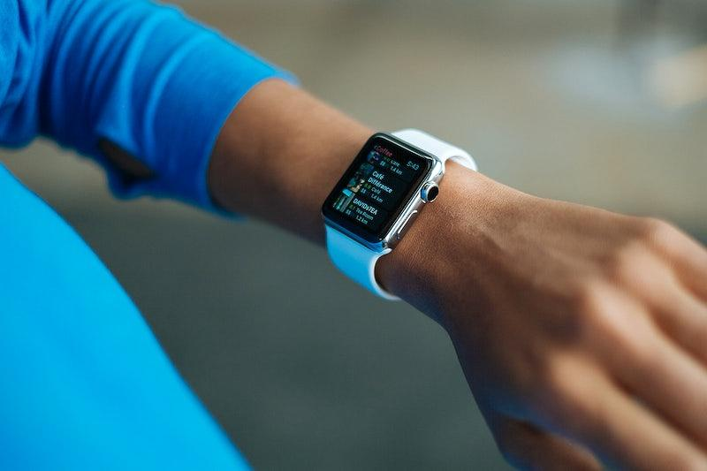
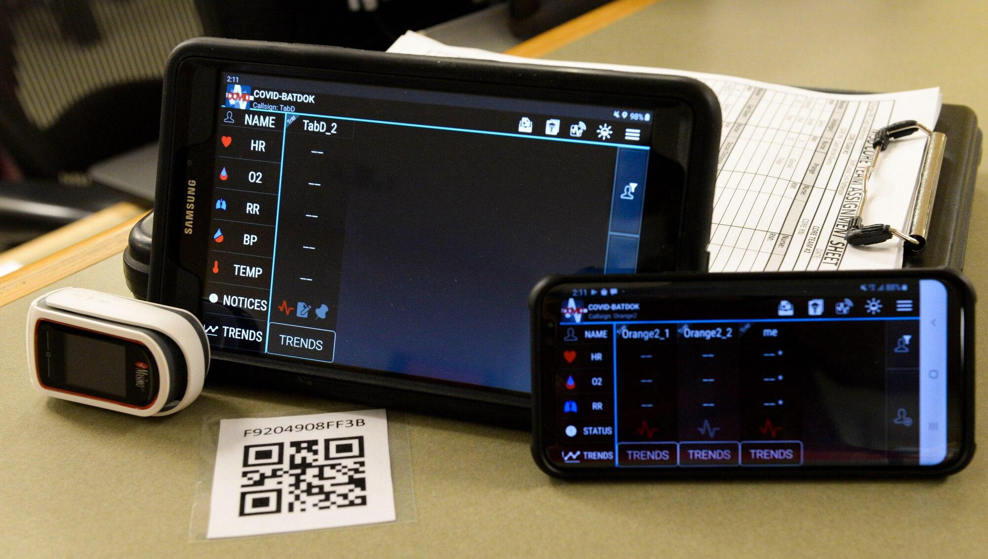
Future scope
Capable of integrating with smartphone, smartwatch, etc.
Can be interfaced to doctor’s devices for real time alerts through IOT.
Incorporation of Artificial Intelligence
Notes:
The final product can be worked upon for serving it’s extended potential in the future that enables users to fully utilise the functionality and remotely access it to get the intended data for treatment purposes. This can be done by integrating an app in the smartphone or smartwatch which enhances data collection and usage across devices and makes up for a hasslefree experience with added functionality for manually operating through the device if the user intends to. The prototype can be interfaced with doctor’s devices through IOT for real time alerts which would help the doctor to keep track of the patients’ data when the values or parameters exceed the required threshold. On top of that, we could incorporate artificial intelligence to detect the average resting heart rate and snoring pattern of the patient to get more accurate sensing data and a more reliable operation of the elevation pattern. For future developments we could use voice activation or voice recognition for a more seamless experience of the product.

Slide 12
References
Research Paper: Congestive Heart Failure (nursinganswers.net)
Congestive Heart Failure Research Paper.docx - Congestive Heart Failure (CHF) 1 Congestive Heart Failure (CHF) HIT 160: | Course Hero
Congestive Heart Failure: Prevention, Treatment and Research | Johns Hopkins Medicine
Congestive Heart Failure - StatPearls - NCBI Bookshelf (nih.gov)
Congestive Heart Failure: Symptoms, Causes, Treatment, Types, Stages (webmd.com)
Comparison of congestive heart failure annual incidence per decade... | Download Scientific Diagram (researchgate.net)
Nectar Adjustable Bed frame | 50-Nights Trial | 3 Yr Warranty (nectarsleep.com)
Ebern Designs Sykora 26.8" Wide Faux Leather Manual Club Recliner | Wayfair
https://hackaday.com/2017/03/11/pulse-oximeter-is-a-lot-of-work/

